Slide 1




Predicting Brain Activity while Listening to Stories
Subba reddy Oota, Frederic Alexandre, Xavier Hinaut

Slide 2
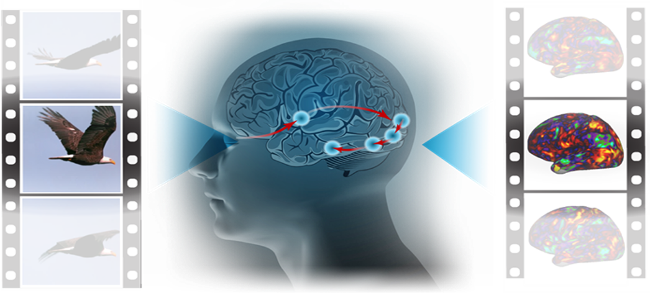
Brain Encoding vs Decoding
Stimulus
Encoding
fMRI
Stimulus
Decoding
fMRI
Haiguang Wen et al, 2017

Slide 3
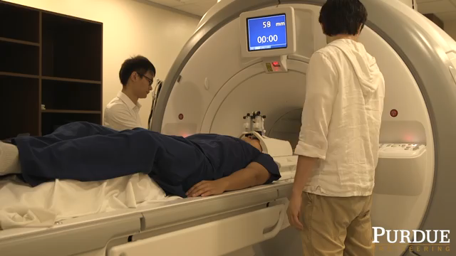
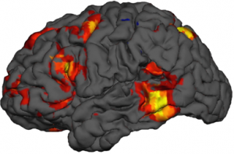
What is fMRI?
https://www.biopac.com/events/fmri-psych/

Slide 4
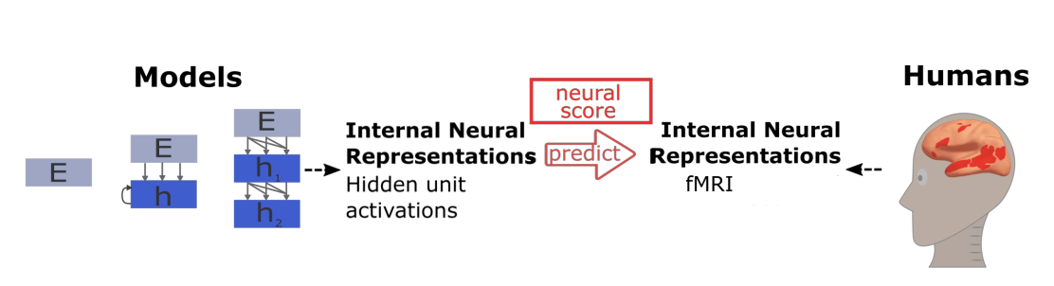
Brain Encoding
Stimulus
Present
Schrimpf et al. 2021 fMRI

Slide 5
Brain Encoding
Stimulus
Stimulus
Present
Present
Schrimpf et al. 2021 fMRI

Slide 6
Brain Encoding
Stimulus
Stimulus
Present
Present
Input
Ridge Regression
Output
Schrimpf et al. 2021 fMRI

Slide 7
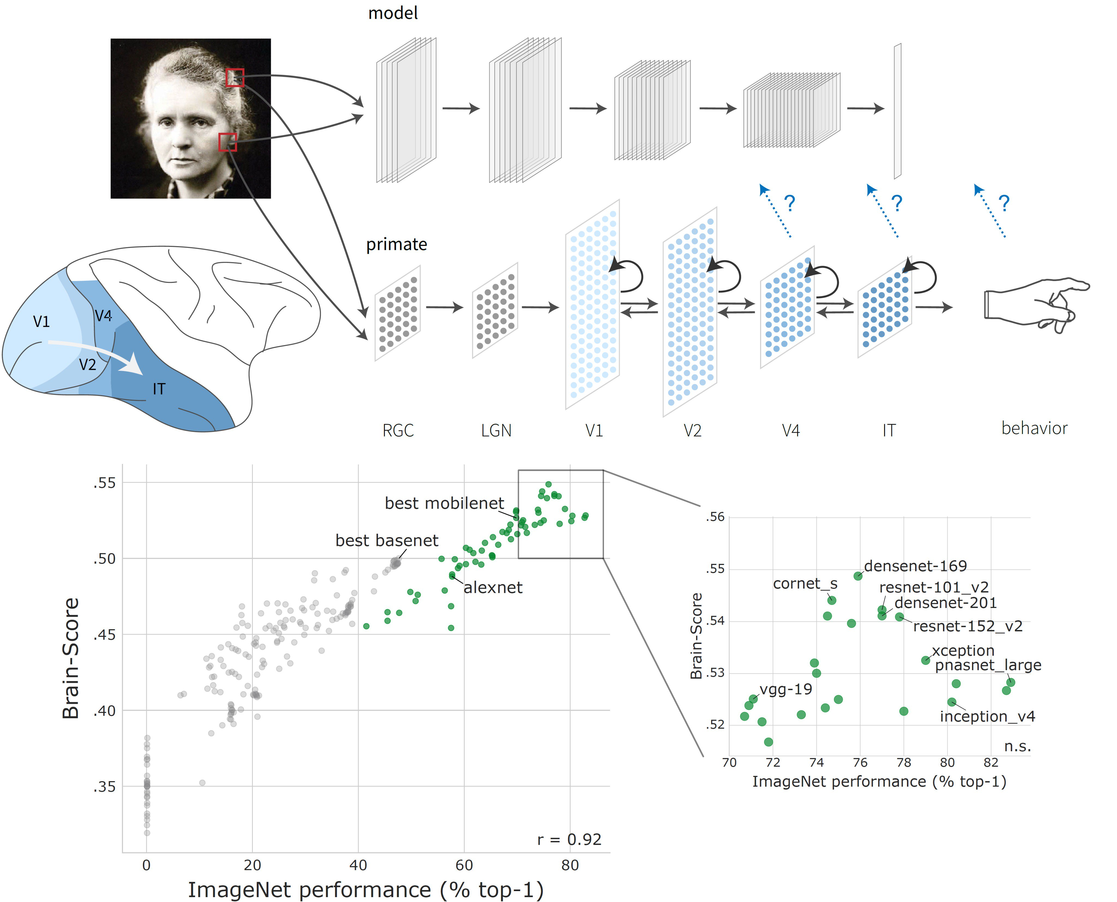
Vision models accurately predict human vision recordings
Schrimpf*, Kubilius*, et al. 2018 | Kubilius*, Schrimpf*, et al. 2019

Slide 8
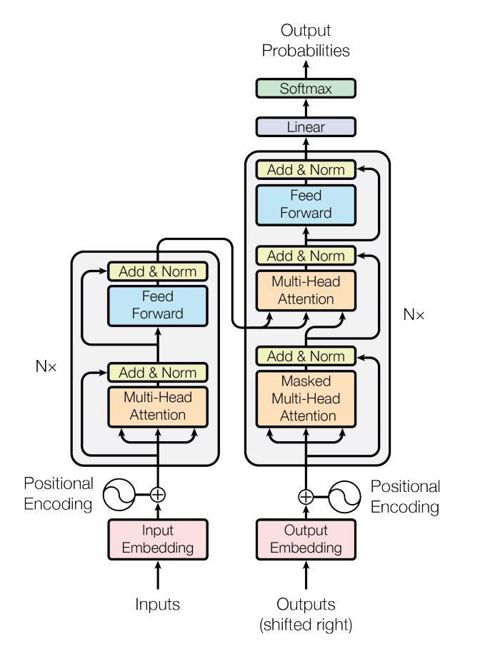
Most popular language models are Tranformers
Transformer language models
(BERT, XML, GPT,…)
Vaswani et al. 2017

Slide 9
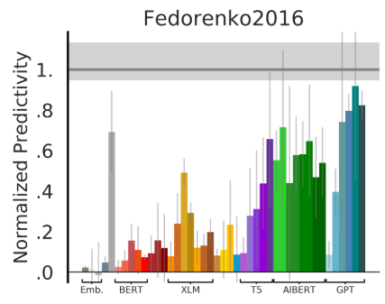
Language models based on words
Words
Stimulus
Transformer language models
(BERT, XML, GPT,…)
Vaswani et al. 2017, Schrimpf et al. 2021

Slide 10

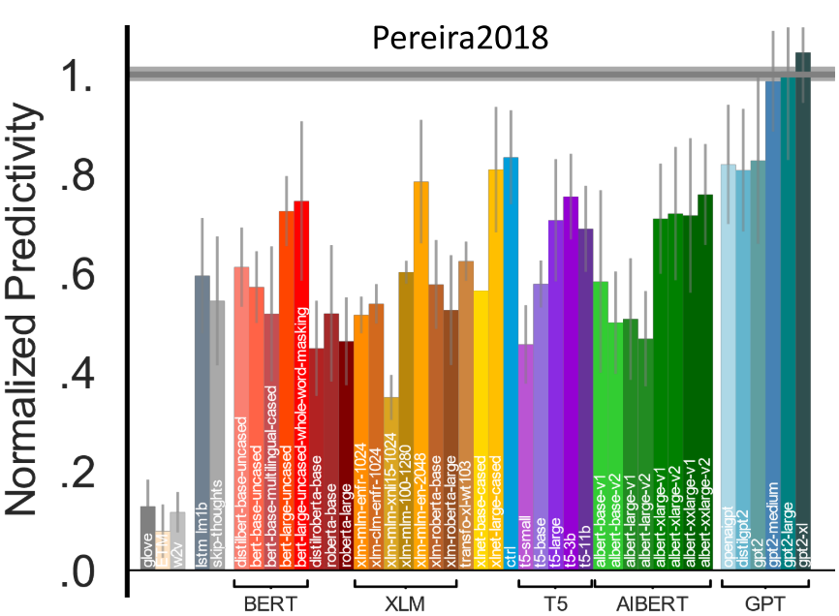
Language models based on sentences
Sentences
Stimulus
Transformer language models
(BERT, XML, GPT,…)
Vaswani et al. 2017, Schrimpf et al. 2021

Slide 11

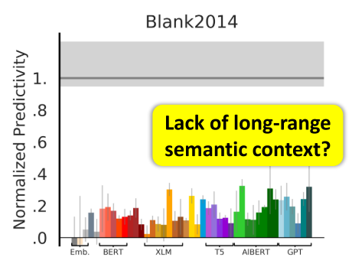
Can current language models deal with long-term dependencies?
Paragraphs
Stimulus
Transformer language models are unable to handle the long-term dependencies
sequence length is fixed to 512 words
LSTMs still lacks investigation of the long-term memory cognitive plausibility and its link to fMRI data
Vaswani et al. 2017, Schrimpf et al. 2021

Slide 12
What kind of language models can represent long-term dependencies?
could they also predict higher cognition while subjects are engaged in longer stories ?

Slide 13
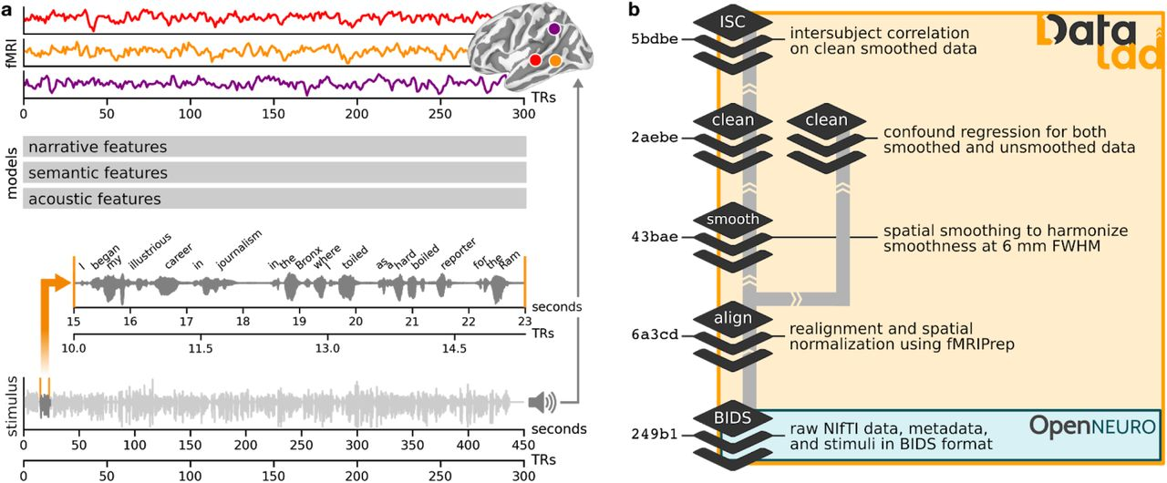
The data target: human brain recordings
We use Pieman story listening:
82 subjects,
259 TRs (repetition time)
here it is 1.5 sec.
Example: ''I began my illustrious carrier in journalism…''
Nastase et al. 2021 fMRI

Slide 14
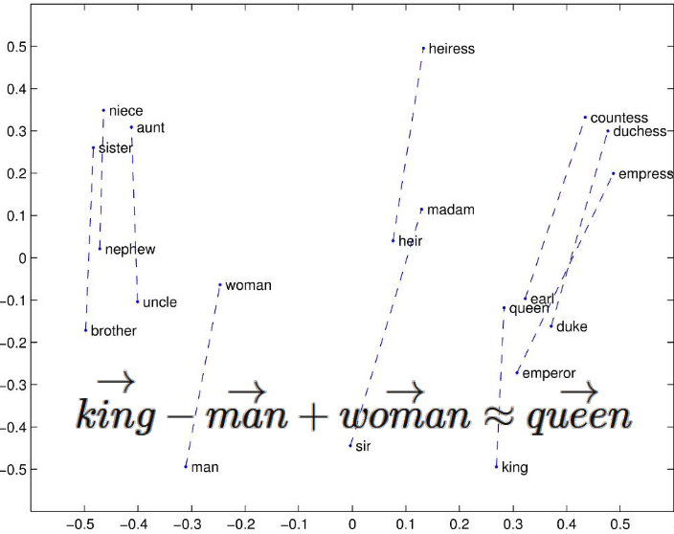
Models considered (n = 5)
Embedding type models: GloVe
GloVe
e.g. Pennington et al. 2014 | Hochreiter et al. 1997 | Peters et al. 2018 | Beltagy et al. 2020

Slide 15
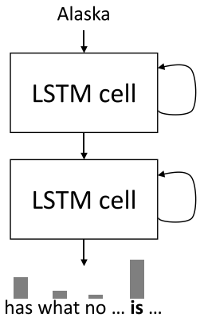
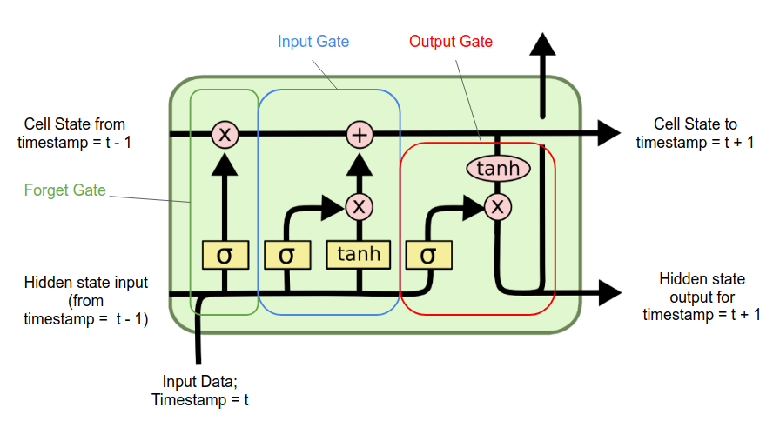
Models considered (n = 5) Contd.
Embedding type models: GloVe
Recurrent type models: LSTM, RandLSTM
Long Memory
Short
Memory
LSTM
e.g. Pennington et al. 2014 | Hochreiter et al. 1997 |Peters et al. 2018 | Beltagy et al. 2020

Slide 16
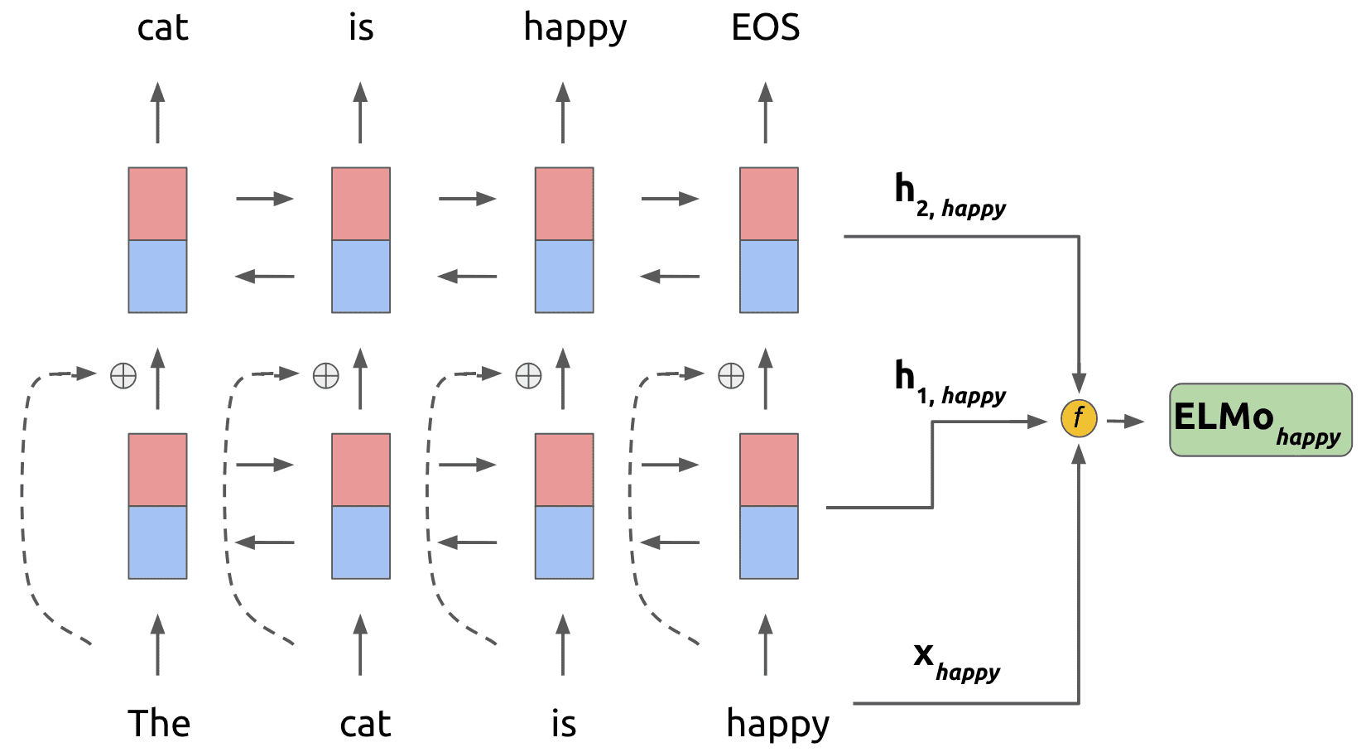
Models considered (n = 5) Contd.
Embedding type models: GloVe
Recurrent type models: LSTM, RandLSTM
Contextualized pretrained models: ELMo, Longformer
Layer-2
Layer-1
ELMo
e.g. Pennington et al. 2014 | Hochreiter et al. 1997 | Peters et al. 2018 | Beltagy et al. 2020

Slide 17
Models considered (n = 5) Contd.
Embedding type models: GloVe
Recurrent type models: LSTM, RandLSTM
Contextualized pretrained models: ELMo, Longformer
Longformer: Transformer with Global + local sliding window
e.g. Pennington et al. 2014 | Hochreiter et al. 1997 | Peters et al. 2018 | Beltagy et al. 2020

Slide 18
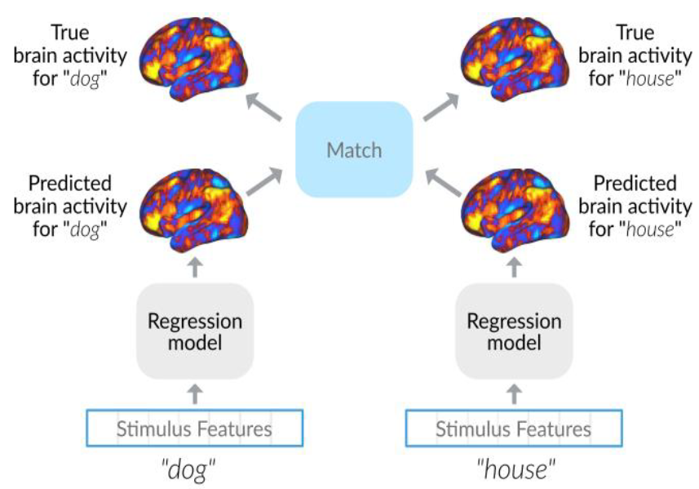
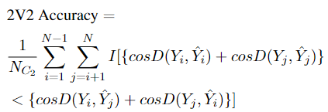
Evaluation Metrics: 2V2 and Pearson
Cosine distance
2V2 Accuracy

Slide 19
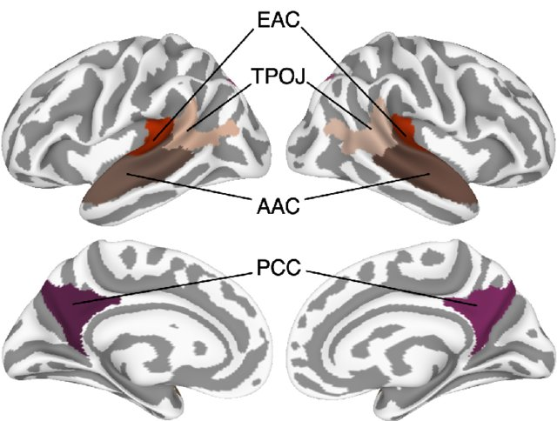
Language Hierarchy in Brain
EAC – Early auditory cortex
AAC – Auditory association cortex
TPOJ – Temporo-parieto-occipital junction
DFL – Dorsal frontal lobe
PMC – Posterior medial cortex
Nastase et al. 2019

Slide 20
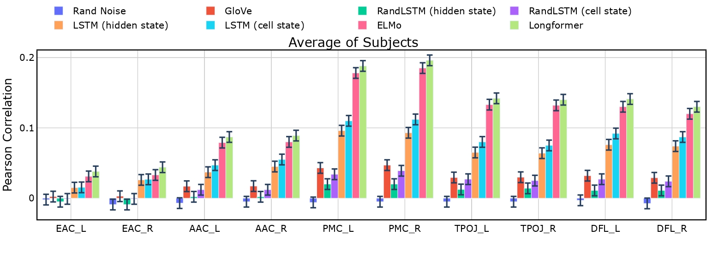
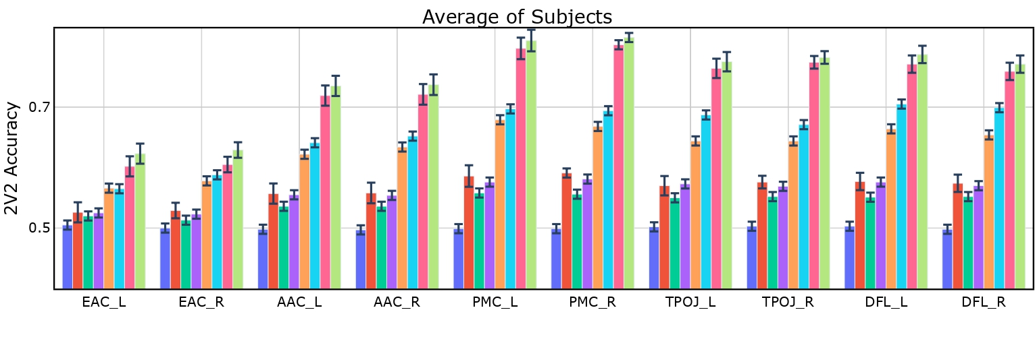
Encoding Performance of language models

Slide 21
Encoding Performance of language models

Slide 22
Encoding Performance of language models

Slide 23
Encoding Performance of language models

Slide 24
Summary
Language models with longer context better predict brain activity while subjects listening to stories.
Future Directions:
Use more plausible language models than Transformers
Make hierarchical language models
Sub-part of the model predict different language levels: phonemes, words, POS, SRL
THANK YOU

